Slide 1

CSMA/CA Simulation
The 802.11 standard specifies a carrier sense multiple access with collision avoidance (CSMA/CA) protocol.
In this protocol, when a node receives a packet to be transmitted, it first listens to ensure no other node is transmitting.
If the channel is clear, it then transmits the packet. Otherwise, it chooses a random backoff factor which determines the amount of time the node must wait until it is allowed to transmit its packet, thus reducing the probability of collision.
Course Name: Networking Level(UG/PG): UG
Author(s) : Amitendu Panja, Veedhi Desai
Mentor: Aruna Adil
*The contents in this ppt are licensed under Creative Commons Attribution-NonCommercial-ShareAlike 2.5 India license

Slide 2
Learning Objectives
After interacting with this Learning Object, the learner will be able to:
- understand the working of CSMA/CA protocol.

Slide 3
Theory
1
The 802.11 standard specifies a carrier sense multiple access with collision avoidance (CSMA/CA) protocol.
In this protocol, when a node receives a packet to be transmitted, it first listens to ensure no other node is transmitting.
If the channel is clear, it then transmits the packet. Otherwise, it chooses a random back off factor which determines the amount of time the node must wait until it is allowed to transmit its packet.
During periods in which the channel is clear, the transmitting node decrements its back-off counter. (When the channel is busy it does not decrement its back-off counter.)
When the back-off counter reaches zero, the node transmits the packet.
Since the probability that two nodes will choose the same back-off factor is small, collisions between packets are minimized.
Collision detection, as is employed in Ethernet, cannot be used for the radio frequency transmissions of IEEE 802.11.
The reason for this is that when a node is transmitting it cannot hear any other node in the system which may be transmitting, since its own signal will drown out any others arriving at the node.
2
3
4
5

Slide 4
Theory
1
In CSMA/CA a Wireless node that wants to transmit performs the following sequence:Listen to the desired channel.
If the channel is sensed to be free for a DCF inter-frame space (DIFS) time interval the transmission will proceed.
If the channel is busy the node defers its transmission until the end of the current transmission and then it will wait an additional DIFS interval and generate a random back-off delay uniformly chosen in the range [0, W − 1] where W is called the back-off window or contention window (CW). The back-off timer is decreased as long as the channel is sensed to be idle for a DIFS, and frozen when a transmission is detected on the channel, and resumed when the channel is detected as idle again for a DIFS Interval.
When the back-off reaches 0, the node transmits packet otherwise it repeats the process mentioned above until it gets a free channel.
A short inter-frame space (SIFS) is used to give priority access to ACK packets.
When receiving a packet correctly, the destination node waits for a SIFS interval immediately after the reception has completed and transmits an ACK back to the source node confirming the correct reception. If the source node does not receive an ACK due to collision or transmission errors it reactivates the back-off algorithm after the channel remains idle for an extended IFS (EIFS) interval.
2
3
4
5

Slide 5
Definitions of the components/Keywords:
ACK: The receiving node sends an acknowledgement packet (ACK) after receiving packet.
IDLE: Channel is free.
SENSING: The node senses the channel to determine whether another node is transmitting before initiating a transmission.
SENDING: Sends packets.
BACKOFF: When channel is busy,backoff interval is set. Count down the backoff interval when medium becomes idle.Count down is suspended if medium becomes busy again. When backoff interval reaches 0, transmit.

Slide 6
Definitions of the components/Keywords:
DIFS: DCF inter frame space. If the channel is continuously idle for DCF Interframe Space (DIFS) duration, only then sender is supposed to transmit a frame. If the channel is found busy during the DIFS interval, the sender should defer its transmission.
SIFS: Short inter frame space. It is the small time interval between the data frame and its acknowledgment. When receiving packet correctly,the destination node waits for a SIFS interval immediately after the reception has completed and transmits an ACK back to the source node confirming the correct reception.
WAIT_FOR_ACK: Waits for acknowledgement from receiver.
COLLISION: When more than one packet is transmitted at the same time collosion occurs.

Slide 7
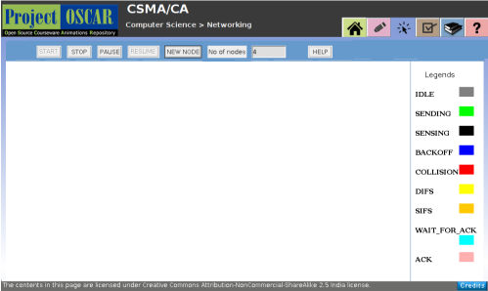
Master Layout 1
1
2
3
User's Action
4
User's Action
Output
When user clicks
“Demo Button”---->
This is the output which appears to the user.
5

Slide 8
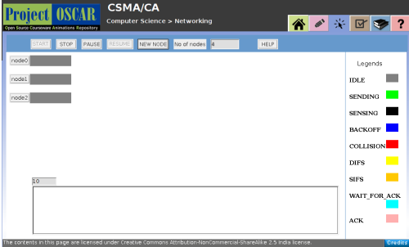
Start Button
Step 1:
1
2
3
4
User's Action
Output
When user clicks
“Start Button”---->
Channel for all three nodes appears idle.
5

Slide 9
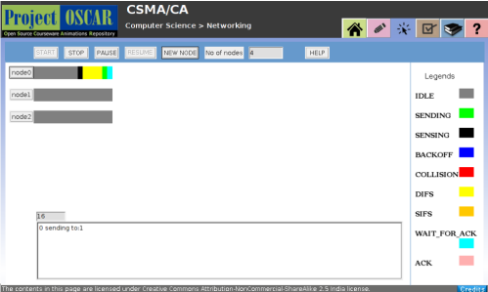
Node 0
Step 2:
1
2
3
4
User's Action
Output
When user clicks
“node 0”----->
2.Node 1 and Node 2 are
not active
i.e. they are IDLE
Node 0 starts SENSING the medium. It then goes in DIFS since the medium is idle-->starts SENDING the packet---> WAIT_FOR_ACK
Node 1 and Node 2 are idle.
5

Slide 10
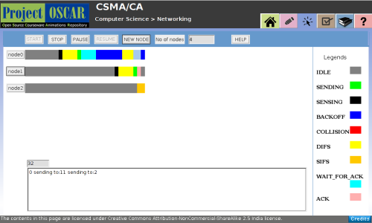
Step 3:
Node 1
1
2
3
4
User's Action
Output
When user clicks
“node 1”---->
Node 1 starts SENSING the medium. It then goes in DIFS since the medium is idle -->starts SENDING the packet---> gets ACKNOWLEDGMENT--->again goes to IDLE state since it received acknowledgment
Node 0 is in the BACKOFF and Node 2 is IDLE
5

Slide 11
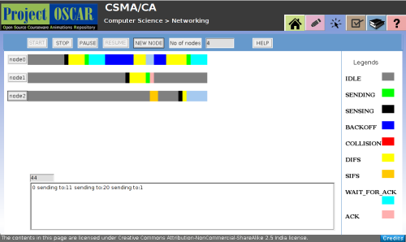
Node 2
Step 4:
1
2
3
4
User's Action
Output
When user clicks
“node 2”---->
Node 2 starts sensing the medium. It then goes in SIFS since it received acknowledgment -->again goes to IDLE state ---> starts SENSING the medium--->goes to DIFS--->goes to BACKOFF because medium is not free for sending packets.
Meanwhile Node 0 is WAIT_FOR_ACK and Node 1 is in IDLE state.
5

Slide 12
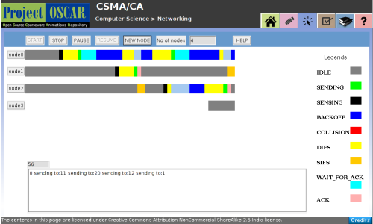
New Node
Step 5:
1
2
3
4
User's Action
Output
When user clicks
“New Node”---->
A new node is generated as and when the user clicks on “new node”.
5

Slide 13
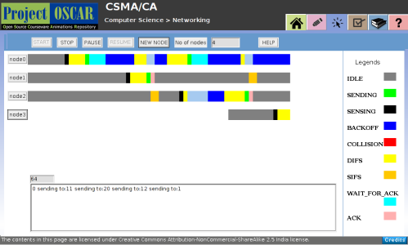
Node 3
Step 6
:
1
2
3
4
User's Action
Output
When user clicks
“Node 3”---->
When the user clicks on new node which is generated (in this case “Node 3”), that node starts sensing the medium.
5

Slide 14
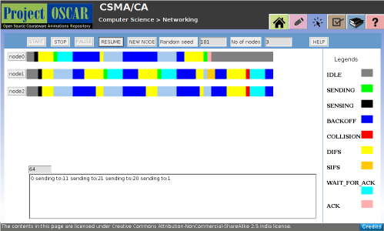
Step 7
:
Collision
1
2
3
4
User's Action
Output
When two or more nodes starts sending together--->
“Collision” occurs when two nodes sends packets at the same time.
In this case Node 1 and Node 2.
Node 0 is not active i.e. It is in the IDLE state.
5

Slide 15
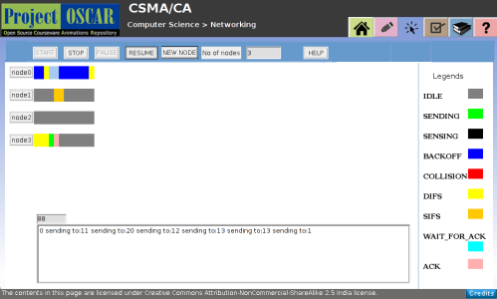
Pause Button
Step 8:
1
2
3
4
User's Action
Output
When user clicks
“Pause”---->
Transmission of packets is “paused” from all nodes.
5

Slide 16
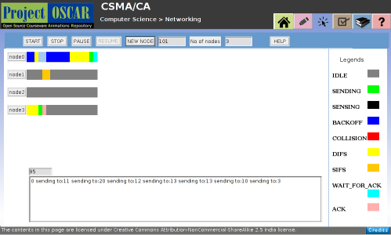
Resume Button
Step 9:
1
2
3
4
User's Action
Output
When user clicks
“Resume”---->
It “resumes” the paused transmission.
5

Slide 17
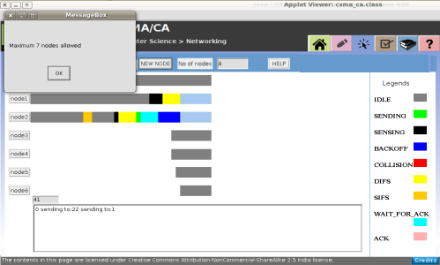
Step 10:
Maximum Number of New Nodes
1
2
3
4
User's Action
Output
When user clicks
“New Node”more than 4 times---->
User is allowed to view only 7 nodes at a time. If user exceeds the given limit than the message box pops up saying “Max 7 nodes allowed”.
5

Slide 18
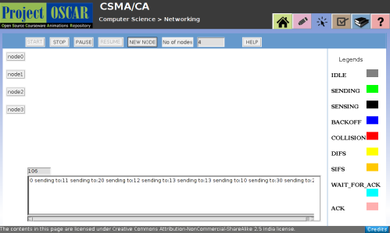
Stop Button
Step 11:
1
2
3
4
User's Action
Output
When user clicks
“Stop”---->
Animation is stopped and when user again clicks “Start” the animation will begin from the start.
5

Slide 19
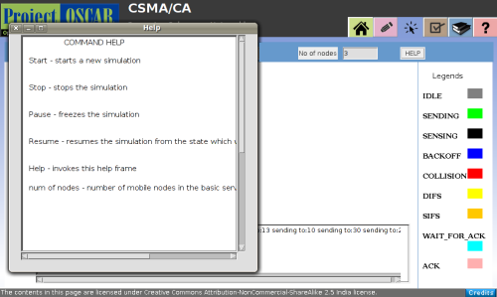
Step 12:
Help Button
1
2
3
4
User's Action
Output
When user clicks
“Help”---->
It pops out the “instructions box” for the user to understand.
5

Slide 20
Electrical Engineering
Slide 1
Slide 3
Slide
19-23
Slide 24
Introduction
Definitions
Analogy
Test your understanding
(questionnaire)‏
Lets Sum up (summary)‏
Want to know more…
(Further Reading)‏
Interactivity:
In this LO demo itself is interactive session.
Try it yourself
Credits

Slide 21
Questionnaire
1
1.A node wants to send a packet over a wireless LAN. What will CSMA/CA protocol do if the channel is idle?
Answers:
a) Sense the channel and send the packet immediately if it is idle.
b) Sense the channel, if it is still idle after DIFS interval, send the packet.
c) Sense the channel, if it is still idle after DIFS interval, enter the back-off phase.
d) None of the above
2
3
4
5

Slide 22
Questionnaire
1
2. A node wants to send a packet over a wireless LAN. What will CSMA/CA protocol do if channel is busy?
Answers:
a) Wait until the channel is idle and send the packet immediately.
b) Wait until the channel is idle, if it is still idle after DIFS interval, send the packet.
c) Wait until the channel is idle, if it is still idle after DIFS interval, enter the back-off phase and check if channel is still idle after the back-off time.
d) None of the above
2
3
4
5

Slide 23
Questionnaire
1
3. What is the purpose of CSMA/CA Protocol in wireless LAN?
Answers:
a) Detect the collision of packets
b) Create different size of packets
c) Avoid the collision of packets
d) None of the above
2
3
4
5

Slide 24
Links for further reading
Reference websites:
www.cs.clemson.edu/~westall/851/802.11/802_CSMA_CA.pdf
http://en.wikipedia.org/wiki/Carrier_sense_multiple_access_with_collision_avoidance
Books:
1. Jochen H. Schiller,Mobile Communications.
2. Brian P Crow, Indra Widjaja, J G Kim,Prescott T Sakai. IEEE 802.11 Wireless Local Area Networks, IEEE Communication Magazine.

